Slide 1
Verticillium Wilt
“Verticillium dahlia”

Slide 2
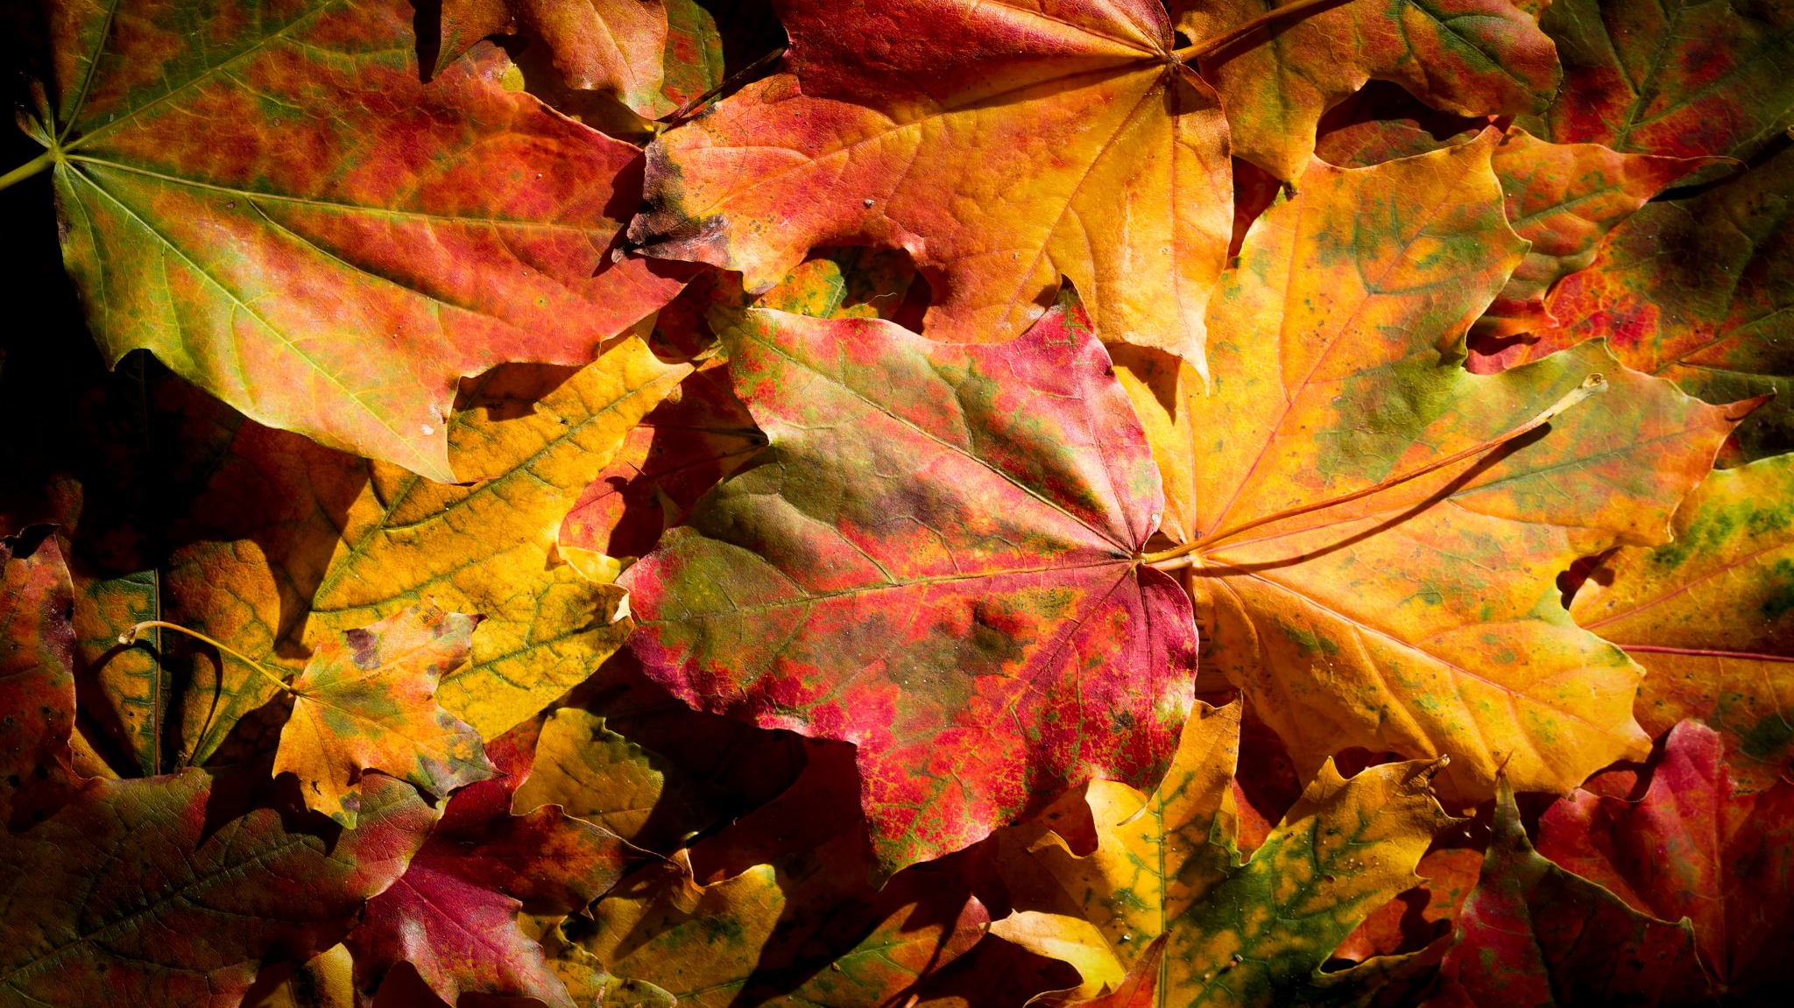
Why do we care?
Soil borne fungal issue
Lives in the soil and can be there for years without evidence.
Kills trees!!
Attacks xylem.
Commonly infected in our area are sugar maple, catalpa, magnolia.
Sugar maple super common on the west side of the twin cities
Many catalpas inside the city with no other apparent issue.
No treatment available currently.

Slide 3

What’s a disease effecting the xylem?
Disease causing the water translocation material of a tree to become plugged.
Diminishes or completely disrupts tree’s ability to pull water up into canopy.
Tip dieback commonly occurs after leaves begin to dry out (dessicate) because they cannot remain hydrated.

Slide 4
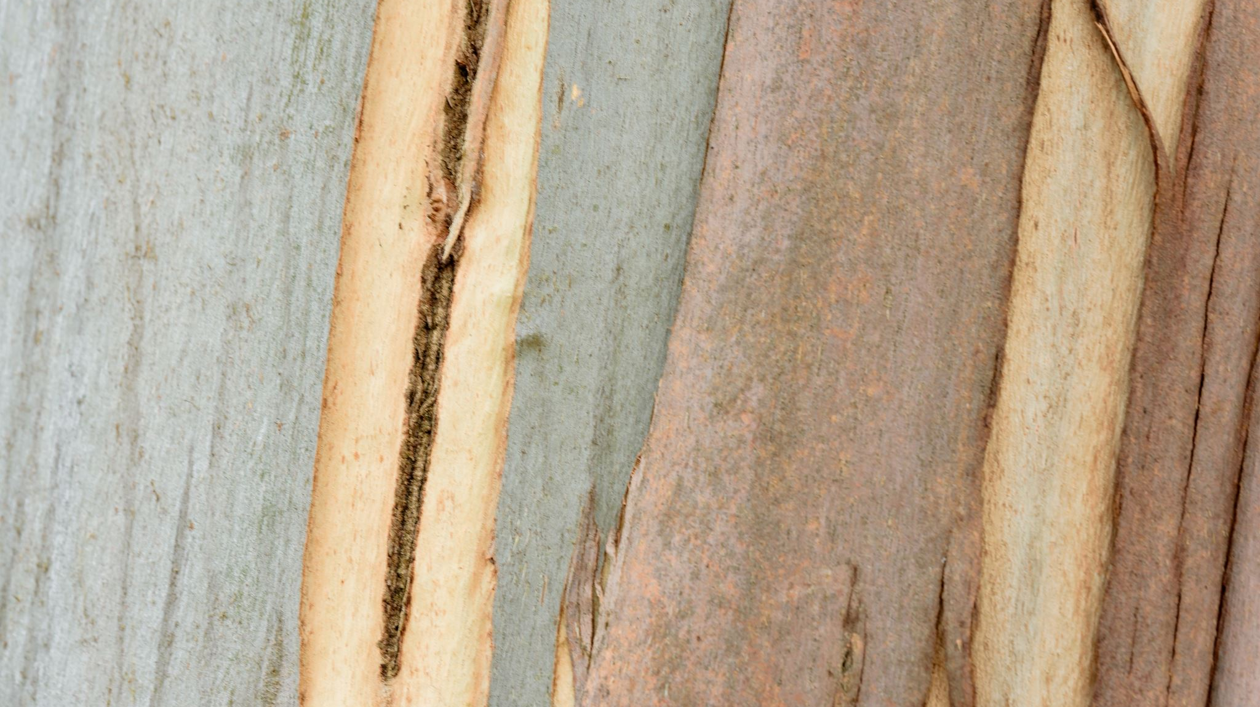
Common Symptoms
Streaks common under bark on twigs but not necessary for ID. Maples streak green, catalpas brown. May or may not see streaks. Lab test guarantees diagnosis.
Abnormal leaf color, wilting throughout canopy, small leaf size, thinning canopy with or without other obvious adverse conditions, tip dieback.

Slide 5

Where does it live?
The fungus that causes Verticillium Wilt lives in the soil.
It cannot be removed.
Fungal bodies infect roots where it is pulled up into the canopy.
Can live in the soil for years with no evidence of its presence.
Trees can be removed and replaced with unsusceptible species.
Oak, Birch, Apple, Hackberry, Pine, Spruce, Walnut, Willow, Ironwood are all among tree species native to MN that are not susceptible to VW.

Slide 6
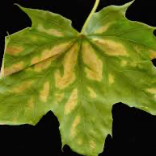

Slide 7
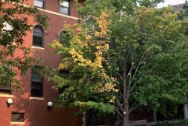

Slide 8
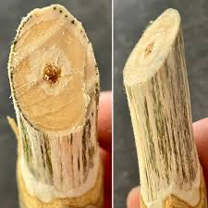

Slide 9
